Slide 1


Upping Your Game: Adding Gamification to Your Instruction
November 6, 2018
If you can’t hear the music, follow these steps:
Click Communicate
Click Integrated Voice Conference
Click Join Conference

Slide 2


Slide 3

Austin Rutledge Coordinator of Instructional Design Oklahoma State University Center for Health Sciences M.Ed., M.S. University of Tennessee austin.rutledge@okstate.edu @austinrutledge
Upping Your Game Agenda
Why gamify your curriculum?
What is gamification?
How do we do this?

Slide 4
Games are Popular

Slide 6

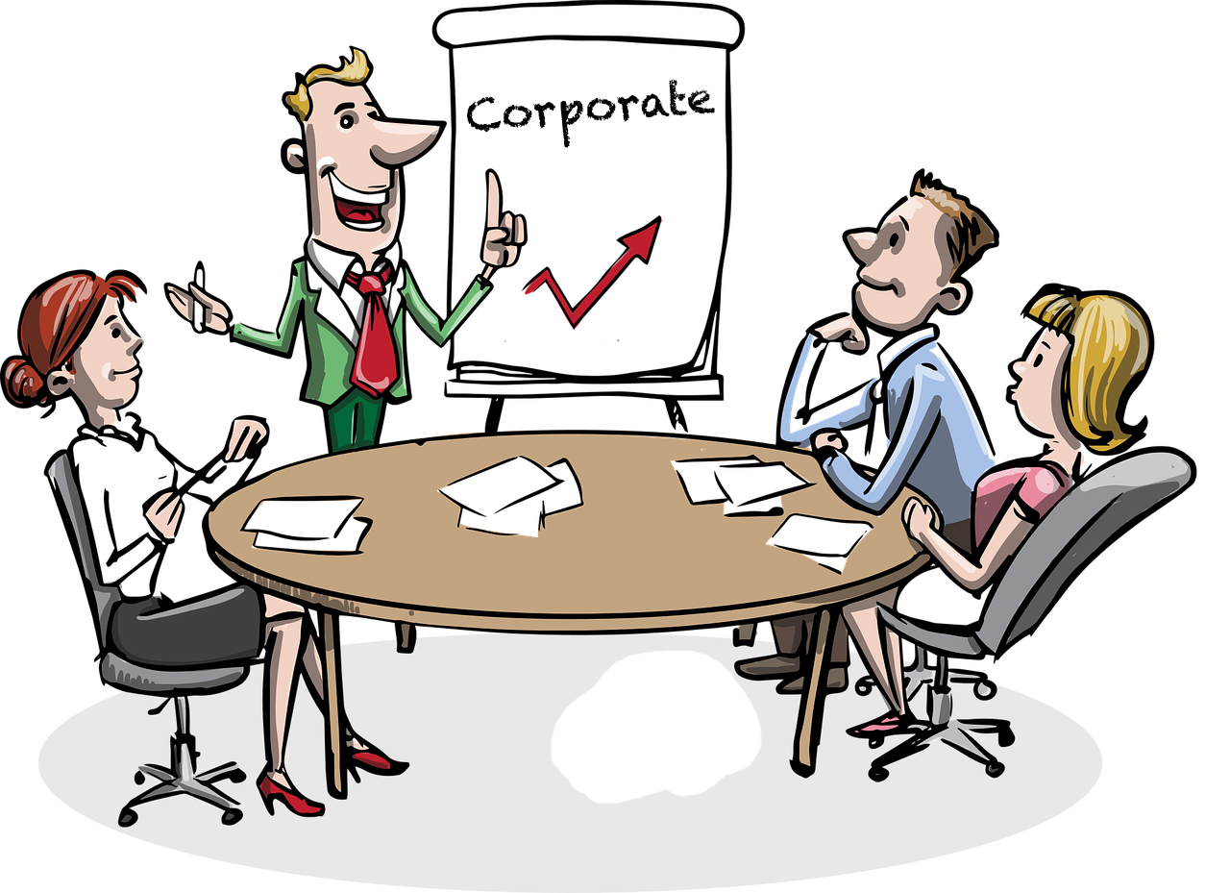
Others are Gamifying
K 12

Slide 7

Others are Gamifying
https://www.medicalbag.com/lifestyle/medical-school-gamification/article/795765/

Slide 9
Defining the Concept
“The use of game elements and game design techniques in non-game contexts."
Werbach, Kevin. ”Definition of Gamification.” [week 1: Gamification]. MOOC offered by the Wharton School of Business. Retrieved on 1 November, 2018 from https://www.coursera.org/learn/gamification/home/welcome. https://www.coursera.org/learn/gamification/home/welcome

Slide 10
Game Elements
Leaderboard
Points
Levels
Progression
Instant Feedback
Team
Choice
Avatars
Rewards
Simulations
Badges
Hidden Messages

Slide 11
Examples

Slide 12
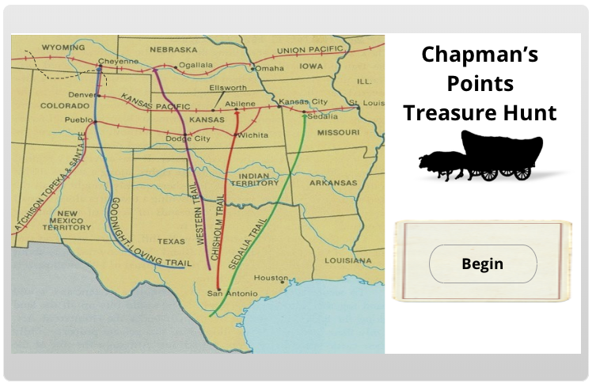
Examples

Slide 13
Examples

Slide 14
Examples

Slide 15
Important Note
“Gamification… does not replace lectures; it is a supplemental tool to support and reinforce established curricula.”
Southern Medical Association (13 September, 2017). Gamification – Transforming Medical Education. Retrieved from https://sma.org/gamification-transforming-medical-education/.

Slide 16
Another Note
Gamification does not necessarily mean that students are playing a game or even utilizing technology at all.
Cline, Abigail (10 May, 2016). GaMed: Gamification of Medical Education. Retrieved from http://in-training.org/gamed-gamification-medical-education-11029.

Slide 17
Okay… How do I Gamify?

Slide 18
Practical Ideas
Quiz games (Kahoot, etc.)
Give learners a choice and provide instant feedback
Develop eLearning content
Utilize student teams
Provide incentives (rewards, badges, etc.)

Slide 19
Too much of A good thing can be a bad thing.
Consider…
How is the experience designed?
Are there too many game elements?
Too many rewards/achievements?
Is it appropriate for the environment and/or the content?
Tynan, K. (11 July, 2017). Gamification: When Too Much of a Good Thing is a Waste of Time and Budget. Retrieved from https://coreaxis.com/when-to-use-gamification/.

Slide 21

health.okstate.edu/oed

Slide 22
Resources
McCory, L., Lewis, J.H., & Dalton, D. (2016) Gamification and Multimedia for Medical Education: A Landscape Review. The Journal of the American Osteopathic Association, 116 (1), 22-34. https://www.ncbi.nlm.nih.gov/pubmed/26745561.
Werbach, Kevin. ”Definition of Gamification.” [week 1: Gamification]. MOOC offered by the Wharton School of Business. Retrieved on 1 November, 2018 from https://www.coursera.org/learn/gamification.
bit.ly/osugames

Slide 23
Austin Rutledge Coordinator of Instructional Design Oklahoma State University Center for Health Sciences M.Ed., M.S. University of Tennessee austin.rutledge@okstate.edu @austinrutledge
Upping Your Game Agenda
Why gamify your curriculum?
What is gamification?
How do we do this?

Slide 24

Tapping Your Video Potential: Panopto & Beyond
Up Next:
November 20, 2018
Dave Juergens
Office of Educational Development
health.okstate.edu/oed
@oedchs

